Slide 1
Leadership in Organizations
Week 4

Slide 2

Topics
Introduction
Leadership traits
Behavioral Approaches
Contingency Approaches

Slide 3
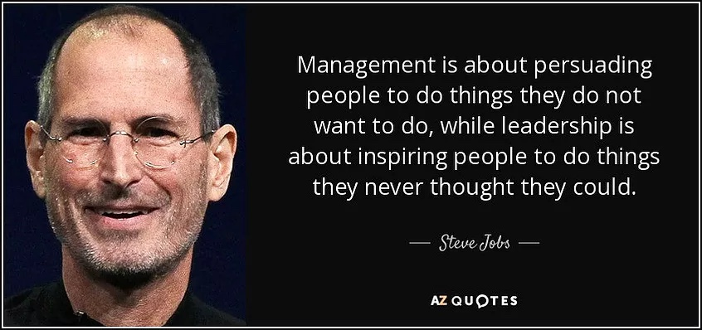

Slide 4
What is Leadership

Slide 5
DEFINITION
Leadership is the process of motivating or influencing other people to act in particular ways in order to achieve specific goals.
Influence
People
Goals

Slide 6
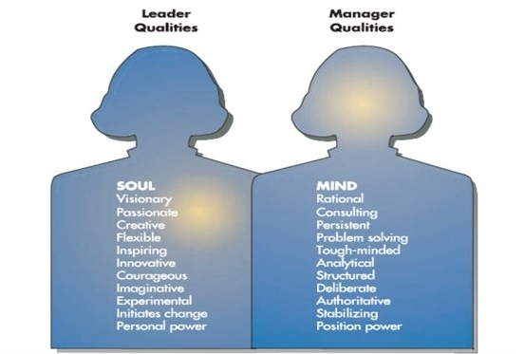

Slide 7
Leadership Traits

Slide 8
Traits
Traits are distinguishing personal characteristics, such as intelligence, values, and appearance.
Early research was focused on leaders who had achieved a level of greatness; ‘ great man approach.

Slide 9
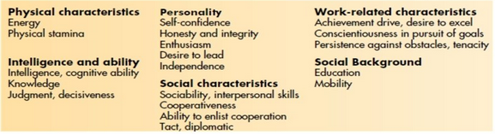

Slide 10
Traits
However, research has revealed the relationship between personal traits and leader success to be weak.
It is dependant on situation and organization.
A shift in focus towards the dynamics of the relationship between leaders and followers.

Slide 11
Styles
Autocratic: A leader who tends to centralize authority and rely on legitimate, reward, and coercive power to manage subordinates
Democratic: A leader who delegates authority to others, encourage participation, and relies on expert and referent power to manage subordinates.

Slide 12
Behavioral Approaches

Slide 13
Ohio State Studies
Conducted in 1940s, it identified leaders as having two major behaviors, which exist independently;
Consideration: A type of leader behaviour that describes the extent to which a leader is sensitive to subordinates, respects their ideas and feelings, and establishes mutual trust.
Initiating structure: A type of leader behaviour that describes the extent to which a leader is task oriented and directs subordinates’ work activities towards goal achievement.
This enabled researchers and practitioners, for the first time, to look at leader behaviors systematically.

Slide 14
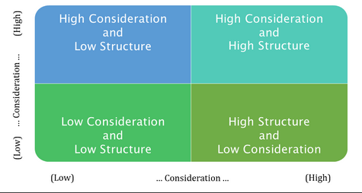

Slide 15
Consideration
Consideration focuses on behaviors that regard the comfort, well-being, status and contributions of followers. Examples of consideration behaviors:
does personal favors for group members;
is easy to understand;
finds time to listen to group members;
backs up the members in their actions;
treats all group members as equals;
is friendly and approachable.

Slide 16
Initiation of structure
Initiation of structure includes behaviors that clearly define a leader’s role and let followers know what is expected. Examples are:
makes his/her attitudes clear to the group;
criticizes poor work;
maintains definite standards of performance;
encourages the use of uniform procedures;
sees to it that the work of group members is coordinated.

Slide 17
Michigan Studies
Comparison of effective and ineffective supervisors, identifying two distinct styles of leadership;
Employee-centered Leadership: Managers using employee-centered leader behavior are interested in developing a cohesive workgroup and ensuring that employees are satisfied with their jobs. The Michigan Leadership Studies found that both the styles of leadership led to an increase in production, but it was slightly more in case of production of job-centered style.
Job-centered Leadership: Managers using job-centered leader behavior pay close attention to subordinates’ work, explain work procedures and are keenly interested in performance.

Slide 18
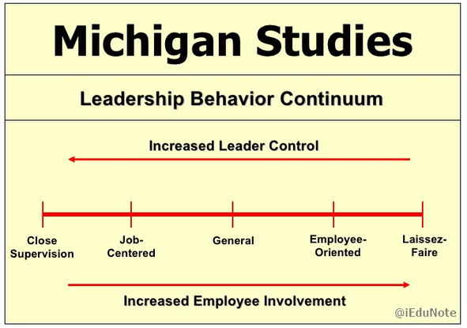

Slide 19
the use of direct pressure and close supervision led to decreased satisfaction and increased turnover and absenteeism.
The employee-centered approach led to the improved work-flow procedure and more cohesion in interactions resulting in increased satisfaction and decreased turnover and absenteeism.
This suggested the superiority of the employee-centered leadership (Participative leadership) style.

Slide 20
Critique
It failed to suggest whether leader behavior is a cause or effect. They did not clarify whether the employee-centered leadership makes the group productive or whether the highly productive group induces the leader to be employee-centered.
It did not consider the nature of the subordinates’ tasks or their characteristics. Group characteristics and other situational variables were also ignored.
The behavioral styles suggested by Michigan Leadership Studies have been termed as static. A leader is supposed to follow either of the two styles, viz., task orientation and employee orientation. But in practice, a practical style may succeed in one situation and fail in another.

Slide 21
The Leadership Grid
It is a two dimensional leadership theory that measures a leader’s concern for people and concern for production.
It builds on the work of both Ohio State and Michigan studies.

Slide 22
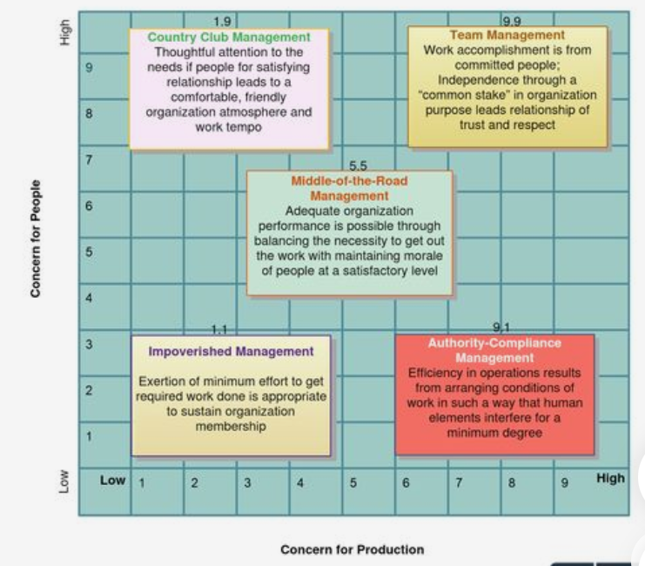

Slide 23
Each axis on the grid consists of a nine-point scale with 1 meaning a low concern and 9 a high concern. Depending on a manager’s score on each of the two axis, you can assign different types of management styles to managers:
Team Management (9,9) often is considered the most effective style and is recommended because organizational members work together to accomplish tasks.
Country Club Management (1,9) occurs when primary emphasis is given to people rather than to work outputs.
Authority-Compliance Management (9,1) occurs when efficiency in operations is the dominant orientation.
Middle-of-the-road Management (5,5) reflects a moderate amount of concern for both people and production.
Impoverished Management (1,1) means the absence of a management philosophy, managers exert little effort towards interpersonal relationships or work accomplishment.

Slide 24
Contingency Approaches

Slide 25
A model of leadership that describes the relationship between leadership styles and specific organizational situations.
Fiedler’s Contingency Theory
Hersey and Blanchard’s Situational Theory
Path-Goal Theory

Slide 26
Fiedler’s Contingency Theory
Aims to match leader’s style with the situation most favorable for his or her success.
Leadership style
Organizational situation

Slide 27
Fiedler’s Contingency Theory
Leadership Style: Style is identified as either relationship oriented or task oriented.
Relationship-oriented leader is concerned with people
Task-oriented leader is primarily motivated by task accomplishment
Least Preferred Coworker (LPC) Scale: A questionnaire designed to measure relationship-oriented versus task oriented leadership style according to the leader’s choice of adjectives for describing the “least preferred coworker”.

Slide 28
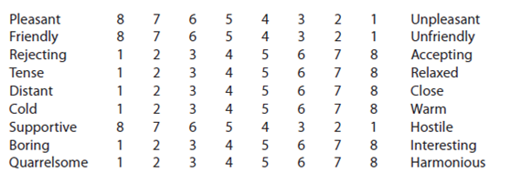
Scale has 16 bipolar adjectives along an 8 point scale.
If LPC is described using positive concepts, means relationship oriented (caring and sensitive towards others feelings)..
If LPC is described using negative concepts, means task oriented (places greater value on tasks than people).

Slide 29
Fiedler’s Contingency Theory
Situation: Analysed in terms of the quality of three elements;
Leader-member relationships, refers to group atmosphere and member’s attitude toward and acceptance of the leader. Good relations mean subordinates trust, respect and have confidence in leader, and vice versa.
Task structure, refers to the extent to which tasks performed by the group are defined, involve specific procedures, and have clear, explicit goals. High task structure is considered as favourable for the leader, and vice versa.
Position power is the extent to which the leader as formal authority over subordinates. High position power is when the leader has the power to plan and direct work of subordinates, evaluate it, reward or punish them making it a favourable position power, and vice versa.

Slide 30
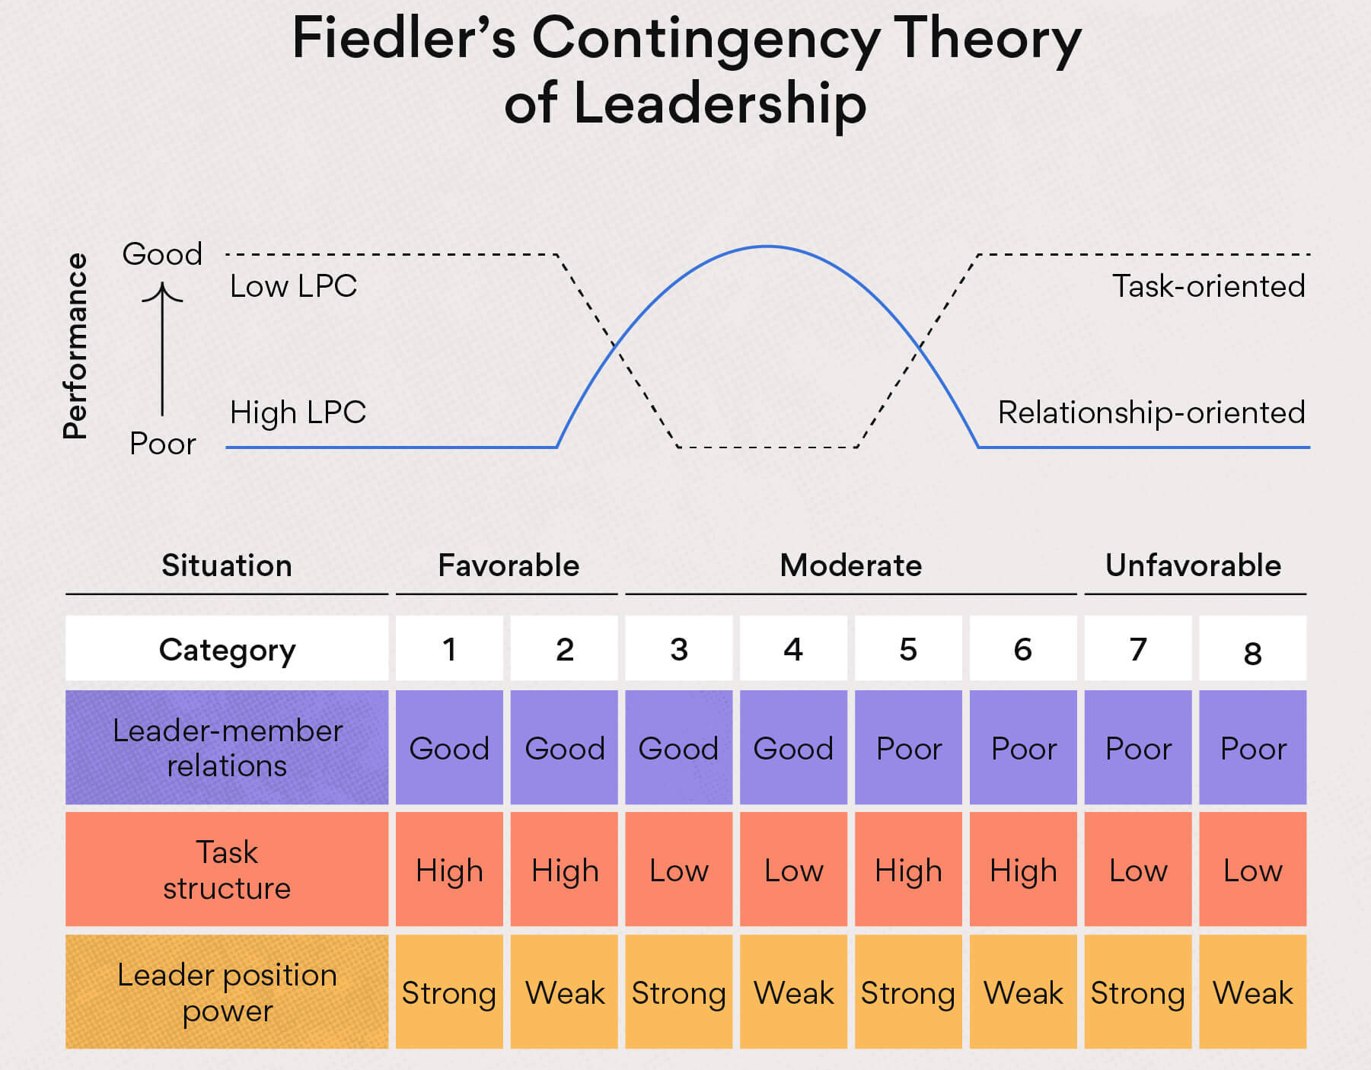

Slide 31
Fiedler’s Contingency Theory
Analysis:
The task-oriented leader excels in the favorable situation because everyone gets along, the task is clear, and the leader has power; all that is needed is for someone to take charge and provide direction.
Similarly, if situation is highly unfavourable to the leader, a great deal of structure and task direction is needed.
A strong leader defines task structure and can establish authority anyway, a strong task orientation will make no difference in the leader’s popularity.

Slide 32
Fiedler’s Contingency Theory
Analysis:
The relationship-oriented leader performs better in situations of intermediate favorability because human relations skills are important in achieving high group performance.
In these situations, the leader may be moderately well liked, have some power, and supervise jobs that contain some ambiguity.
A leader with good interpersonal skills can create a positive atmosphere that will improve relationships, clarify task structure, and establish position power.

Slide 33
Fiedler’s Contingency Theory: scenarios
Imagine you’ve just been hired as a co-manager of a startup tech company. The team of 12 has been working together for a little over a year. You were brought on by the existing manager to help improve the company’s strategy.
Leader-member relations are poor. As a new manager brought into an already tight-knit team, there’s bound to be some friction and distrust.
Task structure is low. The company is still considered a startup, and you were hired to help establish some structure. At this point, everyone helps out with everything.
Leader position power is weak. There’s another manager with more authority who could veto your decisions, especially as they pertain to the team.
According to Fiedler’s Contingency Theory, this scenario calls for a task-oriented leader. The situation is highly unfavorable and a relationship-oriented leader would have a very hard time getting anything done.

Slide 34
Hersey and Blanchard’s Situational Theory
A contingency approach to leadership that links the leader’s behavioral style with the task readiness of subordinates.
This approach focuses a great deal of attention on the characteristics of employees in determining appropriate leadership behavior.
Subordinate’s readiness levels are checked, based on which leadership style is determined.
There are four leadership styles, based on a combination of relationship (concern for people) and task (concern for production).

Slide 35
Hersey and Blanchard’s Situational Theory
Telling Style: high concern for production, low concern for people. Leader gives explicit directions on how the task should be performed.
Selling Style: high concern for both people and production. Leader explains decisions and gives subordinates a chance to ask questions and gain clarity and understanding about work tasks.
Participating Style: high concern for people and low concern for production. Leader shares ideas with subordinates, gives them a chance to participate and facilitates decision making.
Delegating Style: low concern for both people and production. Leader provides little direction and little support, as responsibility for decisions and implementation is given to subordinates.

Slide 36
Hersey and Blanchard’s Situational Theory
Readiness level of subordinates is tier degree of education and skills, experience, self confidence and work attitudes.
Low Readiness Level: poor ability and skills, little experience, insecurity, or unwillingness to take responsibility for their own task behaviour. Leader tells exactly what to do, how to do it and when.
Moderate Readiness Level: subordinates lack some education and experience for the job, but they demonstrate high confidence, ability, interest and willingness to learn. Leader gives direction but also seeks input from others and clarifying tasks.

Slide 37
Hersey and Blanchard’s Situational Theory
3. High Readiness Level: subordinates have the necessary education, experience and skills but might be insecure in their abilities and need some guidance from the leader. Leader guides followers development and act as a resource for advice and assistance.
4. Very High Readiness Level: followers possess high levels of education, experience, and readiness to accept responsibility for their own task behavior. Leader can delegate the responsibility for decisions and their implementation to subordinates, who have the skills, abilities and positive attitude to follow through. The leader provides a general goal and sufficient authority to do the task as followers see fit.

Slide 38
Path-Goal Theory
A contingency approach to leadership specifying that the leader’s responsibility is to increase subordinates motivation by clarifying the behaviours necessary for task accomplishment and rewards.
The model consists of three sets of contingencies:
Leader behaviour and style
Situational contingencies
Use of rewards to meet subordinates’ needs

Slide 39
The leader increases their motivation by either of the two ways:
Path Clarification:means that the leader works with subordinates to help them identify and learn the behaviours that will lead to successful task accomplishment and organizational rewards
Increase Rewards: means that the leader talks with subordinates to learn which rewards are important to them-that is, whether they desire intrinsic rewards from the work itself or extrinsic rewards such a raises or promotions.

Slide 40
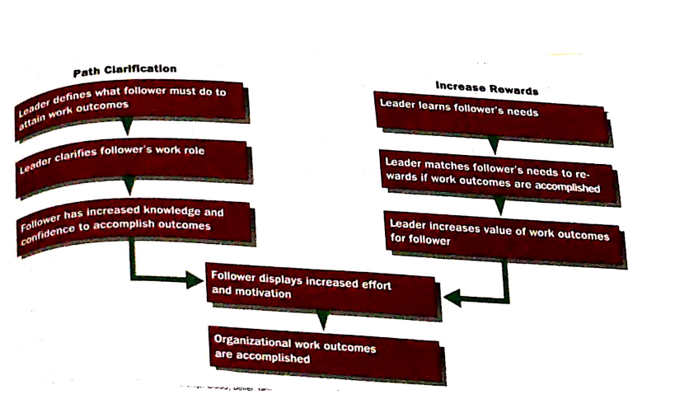

Slide 41
Leader Behaviour
A leader can adopt four types of leadership behaviour:
Supportive Leadership: involves leader behaviour that shows concern for subordinates’ well-being and personal needs. Leadership behaviour is open, friendly, and approachable, and the leader creates a team climate and treats subordinates as equals.
Directive Leadership: occurs when the leader tells subordinates exactly what they are supposed to do. Leader behaviour includes planning, making schedules, setting performance goals and behaviour standards, and stressing adherence to rules and regulations.

Slide 42
Leader Behaviour
A leader can adopt four types of leadership behaviour:
3. Participative Leadership: means that the leader consults with his or her subordinates about decisions. Leader behaviour includes asking for opinions and suggestions, encouraging participation in decision making, and meeting with subordinates in their workplace. Encourages group discussion and written suggestions.
4. Achievement-oriented Leadership: occurs when leader sets clear and challenging goals for subordinates. Leader behaviour stresses high-quality performance and improvement over current performance. Show confidence in subordinates and assist them in learning how to achieve goals.

Slide 43
Situational Contingencies
Two important situational contingencies are:
Personal characteristics of group members: include factors such as ability (low vs high), skills (low vs high) , needs (direction vs autonomy), and motivations (rewards).
Work environment: degree of task structure (extent to which tasks are defined with Job Descriptions and work procedures), the nature of the formal authority system (power wielded by managers, constraints on employees due to policy and rules) , and the work group (educational levels and relationship quality) itself.

Slide 44
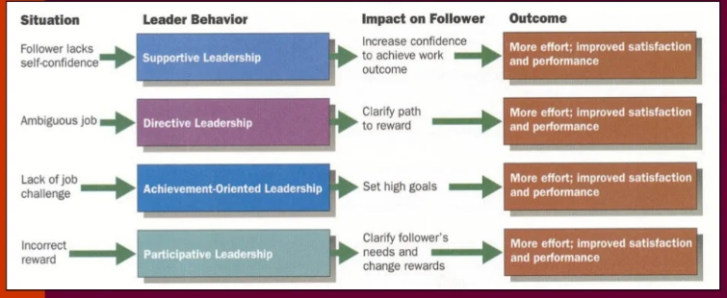
Use of Rewards

Slide 45
Leadership Issues

Slide 46
Leading effectively in today’s environment is likely to involve such challenging circumstances for many leaders:
Managing power
Developing trust
Empowering employees
Leading across cultures
Effective leadership

Slide 47
Managing Power
Leaders get power from five sources, and rely on several different forms of power to affect the behaviour and performance of their followers.
Legitimate Power: obtained as a result of the leader’s position
Coercive Power:the authority to punish or control
Reward Power: the power to give positive rewards
Expert Power: based on leader’s expertise, special skills or knowledge
Referent Power: based on person’s desirable resources or personal traits, is developed due to admiration by followers and their desire to be like that person.

Slide 48
Developing Trust
An important consideration for leaders to build trust and credibility.
Credibility consists of honesty, which is number one attribute admired within a leader. Followers judge a leader’s credibility in terms of his or her honesty, competence, and ability to inspire
Trust is the belief in the integrity, character, and the ability of a leader. Followers who trust a leader are willing to be vulnerable to the leader’s actions because they are confident that their rights and interests will not be abused.

Slide 49
Five dimensions of trust:
Integrity: honesty and truthfulness
Competence: technical and interpersonal knowledge and skills
Consistency: reliability, predictability, and good judgment in handling situations
Loyalty: willingness to protect a person, physically and emotionally
Openness: willingness to share ideas and information freely
Integrity is the most critical when assessing another’s trustworthiness.

Slide 50
Research has shown that trust in leadership is significantly related to positive job outcomes including:
job performance
organizational citizenship behaviour,
job satisfaction
organizational commitment
Downsizing, financial challenges, and the increased use of temporary employees have undermined employees trust in their leaders and shaken the confidence of investors, suppliers and customers.

Slide 51
Empowering Employees
Empowerment is beneficial when employees have the knowledge, skills and experience to do their jobs competently.
Managers are increasingly leading by empowering their employees, through increasing their decision-making authority in the key areas that affect their work directly.
It also results in quick decision making by those people who are most knowledgeable about the issues-often at the lower organizational levels. This is crucial in a dynamic global economy.
Organizational downsizing is another component, whereby managers coped with increased workloads by empowering people.

Slide 52
Leading Across Cultures
Effective leaders adjust their style to the situation, making national culture an important situational variable in determining which leadership style will be most effective.
National culture affects leadership style because it influences how followers will respond.
However, there are universal aspects to leadership, which include vision, foresight, providing encouragement, trustworthiness, dynamism, positiveness and proactiveness.
Effective business leaders in any country are expected by their subordinates to provide a powerful and proactive vision to guide the company into the future, strong motivational skills to stimulate all employees to fulfill the vision, and excellent planning skills to assist in implementing the vision.

Slide 53
Becoming an Effective Leader
There are two components to becoming an effective leader:
Leader training: successful with individuals who are high self-monitors and have the motivation to lead. Implementation skills like trust building, mentoring, situational analytical skills and evaluation skills.
Substitutes for leadership:certain individual, jon and organizational variables can act as substitutes for leadership, negating the influence of the leader.
Follower characteristics like experience, training, professional orientation, need for independence.
Unambiguous and routine jobs or intrinsically satisfying jobs
Organizational characteristics like explicit formalized goals, rigid rules and procedures, cohesive work groups

